Slide 1
Topics to be covered
IoT Application Development
IoT Connectivity
IoT Software Providers

Slide 2
IoT Application Development
IoT application development is the process of building IoT apps or software which combine sensor data with machine learning technologies and predictive analytics to create smart and proactive user experiences.
Sub Topics:
Five main principles that must be taken into account by IoT developers before creating an application.
Developing an Internet of Things-based application: 4 consecutive stages
The top 5 tools to build an Internet of Things application
The Five fastest-growing areas for Internet of Things applications

Slide 3
Five main principles that must be taken into account by IoT developers before creating an application:
Ensure the safe collection of data.
Organize high-performance data streaming.
Create an Internet of Things platform.
Develop an Internet of Things solution in the cloud.
Provide for effective data management.

Slide 4
Developing an Internet of Things-based application:
4 consecutive stages
Select centralized data storage
Develop the server-side of data-handling algorithms
Create a front-end.
Development from scratch

Slide 5
The top 5 tools to build an Internet of Things application
Azure IoT Suite: Azure IoT Hub, Azure stream analytics, Azure storage, Azure CosMos DB, Azure Web Apps.
Amazon Web Services
IBM Watson
Oracle IoT
KAA IoT

Slide 6
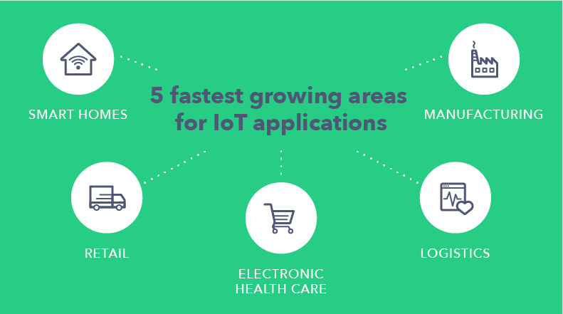
The Five fastest-growing areas for Internet of Things applications:

Slide 7
IoT Connectivity
IoT connectivity is a term defining connection between all the points in the IoT ecosystem, such as sensors, gateways, routers, applications, platforms and other systems. It usually refers to different types of network solutions based on their power consumption, range and bandwidth consumption. IoT projects vary in their requirements and many of them use different connectivity options depending on their needs.

Slide 8
IoT Connectivity :
Why is the selection of the right IoT connectivity option so important?
Which communication option is the best for your IoT project?

Slide 9
IoT Connectivity:
Cellular IoT
Satellite
WiFi
Bluetooth
Ethernet
LPWAN

Slide 10
IoT Software Providers:
Vates: Famous due to Prototype.
Science Soft: Provides IoT consulting, IoT development & Integration, IoT analytics, IoT managed services, IoT application Support.
Oxagile: Provides a full range of services including IoT consulting, Software development, Hardware prototyping, Integration, and Continuous enhancement.
R-Style Lab: provide services for Mobile Applications, Web front-end reporting & analytics, Middleware & Low-level, and backend infrastructure & integration.
HQ Software
PTC: Provides products for CAD, Industrial IoT etc.
CISCO: Provides the solutions of IoT Networking, IoT Gateways, IoT Operations Management, IoT Data Management, and IoT Security.

Slide 11
IoT Software Providers:
ARM: Provides a Device-to-Data Platform for connectivity management, device management, and data management.
Huawei: Provides smart water solutions, Smart Meter Reading, Smoke Detection Smart Building, Smart Factory, Elevators, Smart Parking, Smart Gas, etc.
GE Digital: Provides its products and services to industries like food and beverage, automotive, chemicals, steel manufacturing, semiconductor, pulp & paper manufacturing, water or wastewater, etc.
BOSCH IoT Sensor Company: Provides the IoT Suite for connecting and managing devices, sensors, and gateways
SAP
Seimens IoT Analytics Company: Provides an intelligent gateway
IBM: Provides the IoT solutions of IoT Platform, Watson IoT, Enterprise Asset Management, Facilities Management, and Systems Engineering

